Slide 1
Vehicle Routing Problem Based On Improved Particle Swarm Optimization
INFO 6205 - Final Project
Huizhe Wang || 001614841

Slide 2
Vehicle Routing Problems
an integer NP-complete programming problem.
a generalization of the Travelling salesman problem.
a class of problems to determine a set of vehicle routes, in which each vehicle departs from a given depot, serves a given set of customers, and returns back to the same depot.

Slide 3
Setup for Vehicle Routing Problems
a set of n customers (total number is 48) require a delivery service from only one depot.
A vehicle (ignore its capacity) is stationed at the depot.
The depot could be changed in this project.
Each customer is visited exactly once and the route must start and end at the depot.

Slide 4
The formula of PSO
v_{ij}(t+1) =w*v_{ij}(t)+c_{1*}rand_{1*}(pbest_{ij}−x_{ij}(t)) + c_{2*}rand_{2*}(gbest_{j}−x_{ij}(t))
x_{ij}(t+1) = x_{ij} + v_{ij}(t+1)
Where,
w = inertia weight
c1 = social parameter
c2 = cognitive parameter

Slide 5
Basic Sequence of Swap Construction
Swapping Operators:
SO₁, SO₂, SO₃, ..., SO_{n}
A Sequence of Swap :
SS = (SO1, SO2, …, SOn)
S’ = S+ SS = S + (SO1, SO2, …, SOn)
= [(S + SO1) + SO2] + … + SOn

Slide 6
Basic Sequence of Swap Construction
Example
C: (1 2 3 4 5) and D: (2 3 1 5 4)
Answer
Since C (1) = D (3) = 1, so the first Swap Operator is SO (1, 3), D1=D+SO (1, 3) then the following result can be get:
D1= (1 3 2 5 4)
Since C(2) = D1(3) = 2 , So the second operator is SO(2,3),and D2=D1+SO(2,3),then
D2 = (1 2 3 5 4)
The third operator is SO (4, 5), then
D3=C.
SS=C-D= (SO (1 3), SO (2 3), SO(4 5)).

Slide 7
The improved PSO
V_{id} = wV_{id} ⊕ α * (P_{id} – X_{id}) ⊕ β * (P_{gd} – X_{id}) (3)
Where,
α, β are random number between 0 and 1.
α －－→ personal or local best
β －－→ global best
Notes:
In this formula, Pid means the personal best in the current position of the particles, and Pgd means the global best on the current position of the particles. From here it can be seen that the bigger the value of α, the greater the influence of Pid is, for more Swap Operators in (Pid-Xid) will be maintained, the searching result will toward to local best. The bigger the value of β , the greater the influence of Pgd is, for more Swap Operators in (Pgd-Xid) will be maintained, the searching result will toward to global best.

Slide 8
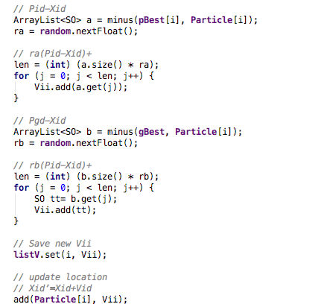
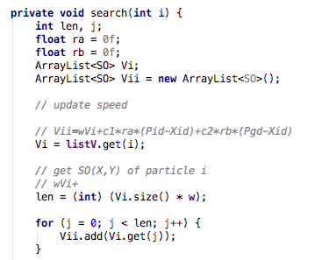
The Main Codes for SOPSO
Notes:
These codes are the application of the formula shown above. W means inertia weight to converge the size of Vi.
These parts are calculating the local best and use ra to give it the proportion of the final result. If ra is bigger, the result will converge to the local best.
These parts are calculating the global best and use rb to give it the proportion of the final result. If rb is bigger, the rusult will converge to the global best.
Then, save the new speed and update the location.

Slide 9
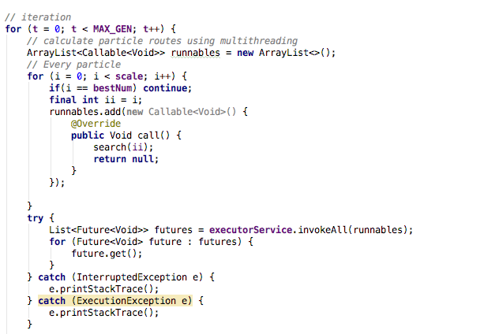
The Main Codes for Multi-threading
Callable/Run
Get value
Notes:
My project use the multi-threading to update the speed. Here, we run the multi-threading, the method search(ii) ,which runs in the multi-threading is shown in the pervious page to update speeds.
And here we get the values.

Slide 10
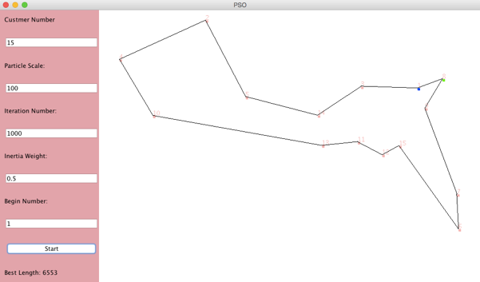
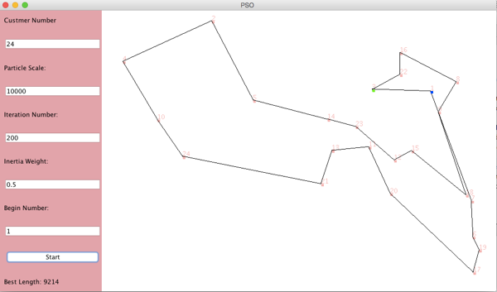


UI and Results

Slide 11
Results
The customer number in this project could be modified. Here are use 15 and 24 to show the difference. The value of ra and rb are randomly.
Run No | Customer Number | Particle Scale | Inertia Weight | Best Length
1 | 15 | 1000 | 0.5 | 7035
2 | 15 | 1000 | 0.85 | 7936
3 | 15 | 5000 | 0.5 | 6644
4 | 15 | 5000 | 0.85 | 7035
5 | 15 | 10000 | 0.5 | 7009
6 | 15 | 10000 | 0.85 | 7013
7 | 24 | 1000 | 0.5 | 9330
8 | 24 | 1000 | 0.85 | 13732
9 | 24 | 5000 | 0.5 | 9081
10 | 24 | 5000 | 0.85 | 13636
11 | 24 | 10000 | 0.5 | 9224
12 | 24 | 10000 | 0.85 | 12585

Slide 12
THANK YOU

